Slide 1

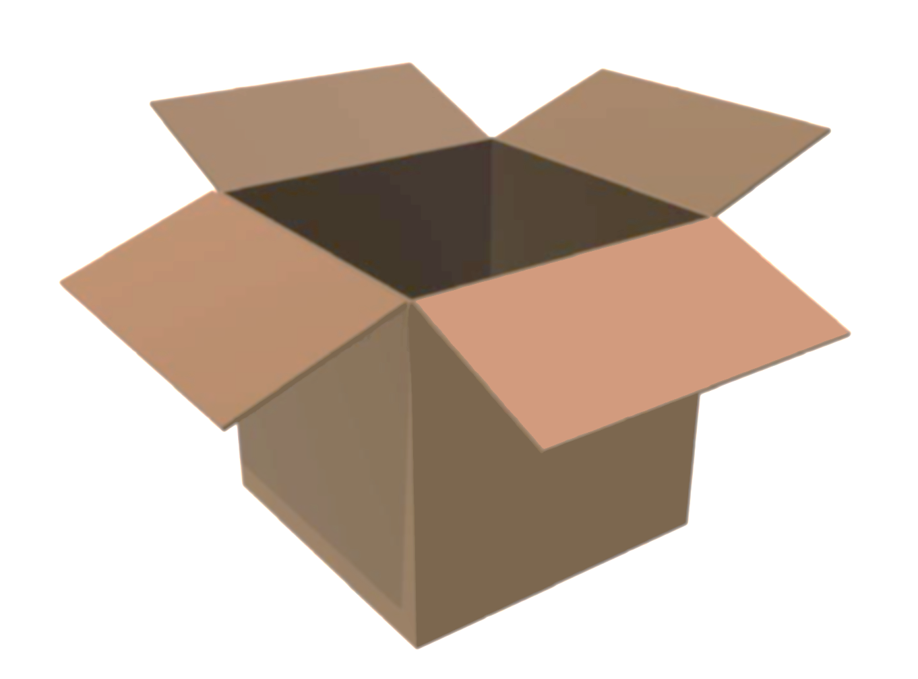


Creating R Packages
Jay Borthen

Slide 2
Setup
Software Requirements:
R and RStudio Desktop
Rtools
devtools package
roxygen2 package

Slide 3
Creating R Packages
COURSE OUTLINE
Setup
  Software requirements
  Course Outline
Tools
  Rtools
  devtools
  roxygen2
Introduction
  Why create an R package?
Structure
  The files and directories that constitute an R package
Documentation and Build
  Implement Roxygen2 comments
  Build and run the package

Slide 4
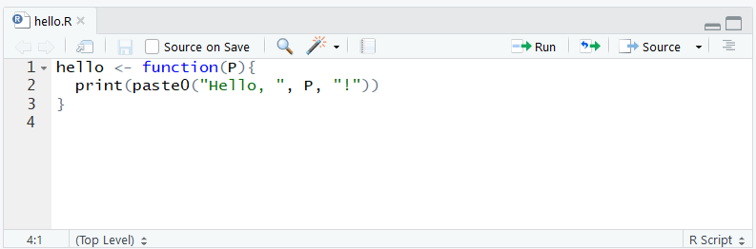
Create example code (for use in demo)

Slide 5
Tools
Rtools, devtools, and roxygen2

Slide 6

Creating R Packages
RTOOLS
Rtools is a collection of tools necessary for building R packages in Windows.
      Multiple compiler toolchains (e.g. GCC and MinGW)
      Compatibility and Testing DLLs (e.g. Cygwin)
      Configuration files
      R source files
      Documentation of protocols
https://cran.r-project.org/bin/windows/Rtools/

Slide 7
Creating R Packages
DEVTOOLS AND ROXYGEN2
The devtools package was specifically developed to assist in the creation of new R packages
      Many of the devtools functions are interchangeable with the functionality built into RStudio
The roxygen2 package provides a convenient way to automate the creation of documentation
      Prior to roxygen2, developers had to write the documentation of R objects directly into the man directory using a LaTeX-style notation
      Thankfully, we can now just insert documentation directly into the R code files by prepending metadata – along with some special annotations – to the beginning of each package function

Slide 8
Introduction
What is an R package and why create one?
An R package is just a directory that contains code and
data that are organized in a standard way.

Slide 9
Creating R Packages
WHAT IS AN R PACKAGE AND WHY CREATE ONE?
Similar to functions, R packages are utilized in order to reuse, simplify, standardize, and share R code and data.
      Reuse - R packages can be used repeatedly which helps avoid writing duplicate code
      Simplify - R packages consolidate and organize functions and data, resulting in a clean and straightforward user experience
      Standardize - R packages allow developers to leverage established conventions to efficiently test and implement code
      Share - R packages can easily be shared between individual developers or published to CRAN and made publicly available
  Anyone who is even moderately familiar with R and RStudio has the ability to develop their own custom R package
An R package is just a directory that contains code and
data that are organized in a standard way.

Slide 10
Structure
The Package Directory

Slide 11
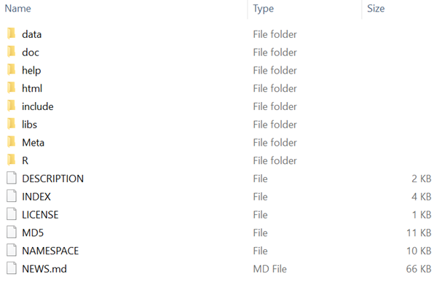
Creating R Packages
THE PACKAGE DIRECTORY
The directory structure of the dplyr package

Slide 12


Creating R Packages
DIRECTORY STRUCTURE OF AN R PACKAGE
NAMESPACE
Every R package contains at least one folder and two files in its top-level directory,
    An R folder – contains the R code files
    A DESCRIPTION file – contains metadata for the package such as package name, version number, author, and dependencies; (RStudio and devtools identifies a directory as a package when the directory contains a DESCRIPTION file)
    A NAMESPACE file – indicates which functions in the package are exported to the user and what functions or other packages are imported
R
DESCRIPTION

Slide 13
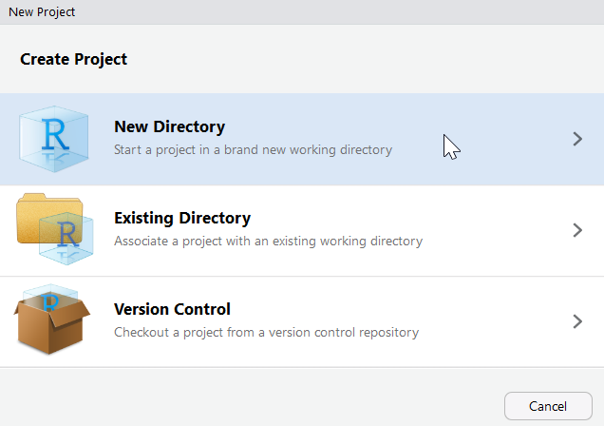
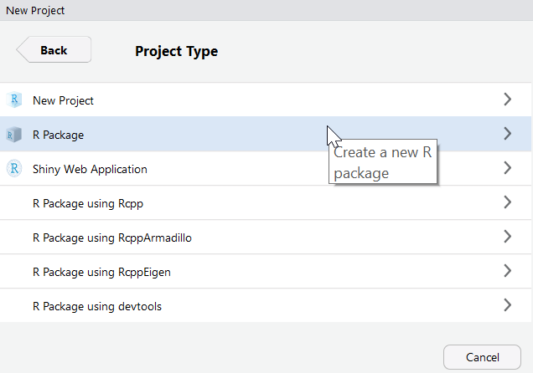
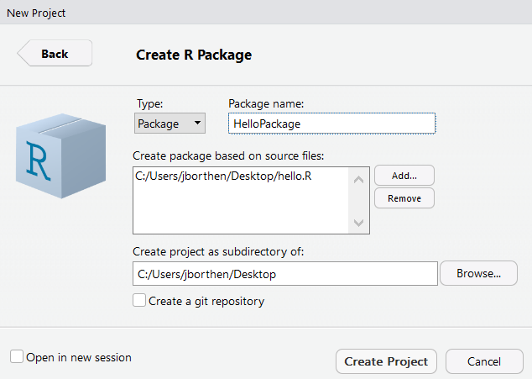
In RStudio,
Go to File → New Project → New Directory → R Package
!
  A package name can only consist of letters, numbers, and periods.
  It must start with a letter and cannot end with a period.

Slide 14
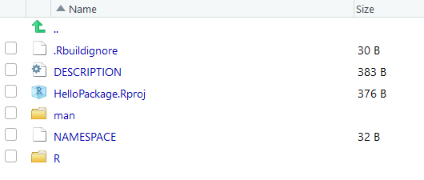
Creating R Packages
THE DESCRIPTION AND NAMESPACE FILES

Slide 15
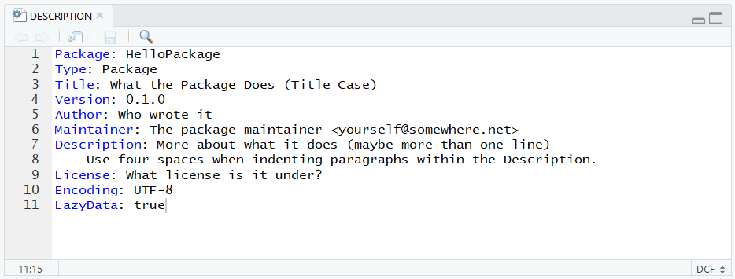
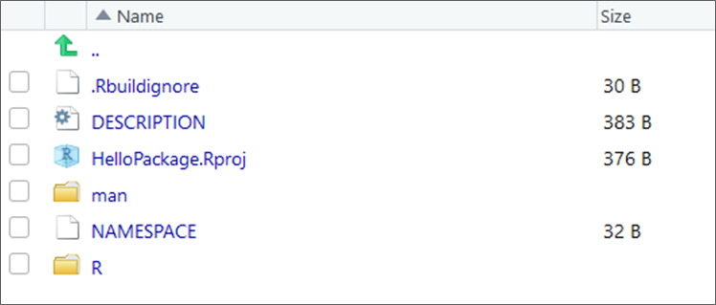
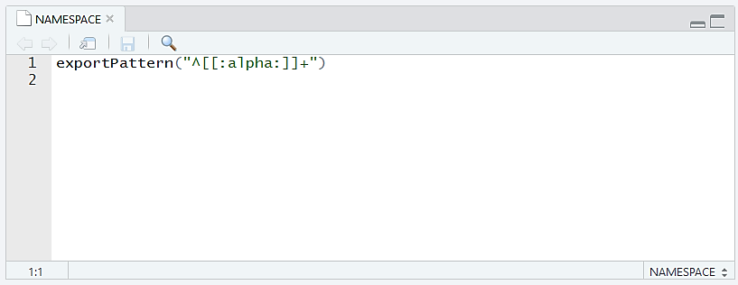
Creating R Packages
THE DESCRIPTION AND NAMESPACE FILES

Slide 16
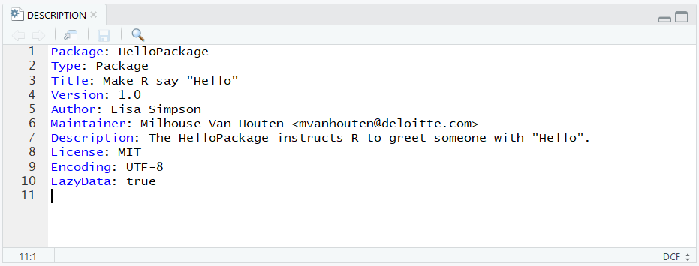
In RStudio,
Open the DESCRIPTION file and replace the default information (example below)

Slide 17
Creating R Packages
THE DESCRIPTION FILE
Imports: stats, graphics
An Imports field lists the external packages that your package relies upon. It can be manually included or auto-populated via the devtools function, use_package(). We will use this function later.
A Suggests field lists the external packages that your package can use but does not necessarily need.

Slide 18
Creating R Packages
THE NAMESPACE FILE
import(stats)
importFrom(graphics, screen)
!
  Never include library() or require() in your package scripts – doing so
  can alter the user’s R environment in unintended ways.
import() – simply takes a package name as an argument, and the interpretation is that all exported functions from that external package will be accessible to your package
importFrom() – takes a package and function names as arguments. This directive allows you to specify exactly which function you need from an external package.
“Imported functions” are functions from other packages.

Slide 19
Creating R Packages
THE NAMESPACE FILE
import(stats)
importFrom(graphics, screen)
export(“hello”)
import() – simply takes a package name as an argument, and the interpretation is that all exported functions from that external package will be accessible to your package
importFrom() – takes a package and function names as arguments. This directive allows you to specify exactly which function you need from an external package.
export() – exported functions must be documented and supported
“Exported functions” are your functions that become accessible to the user.

Slide 20




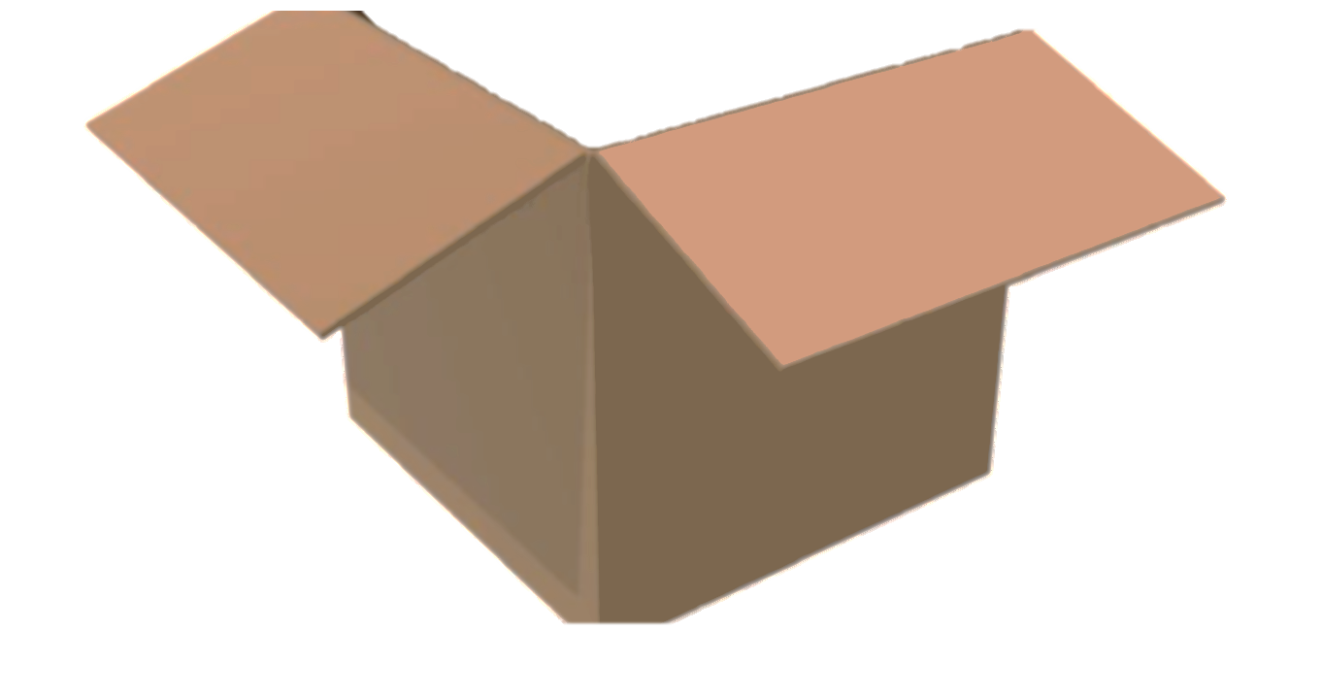
Creating R Packages
INCLUDING DATA IN THE PACKAGE
DATA
Including data in a package is useful for
  Showing new users how to use the package
  Maintaining consistency when using data internally
  Sharing and documenting datasets

Slide 21
In RStudio,
Create a character vector of names:
Then make sure that you are in your package directory and use the use_data() devtools function to bring the data object into your package directory.

Slide 22
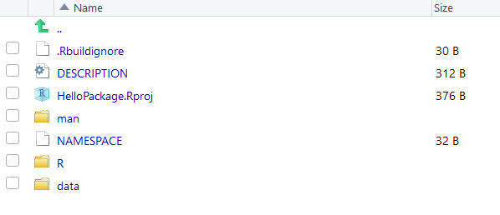
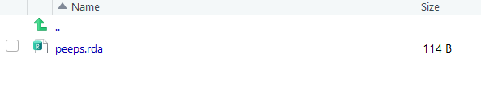
Creating R Packages
INCLUDING DATA IN THE PACKAGE

Slide 23
Documentation and Build
Implementing Roxygen2 and Building
and Running the package

Slide 24
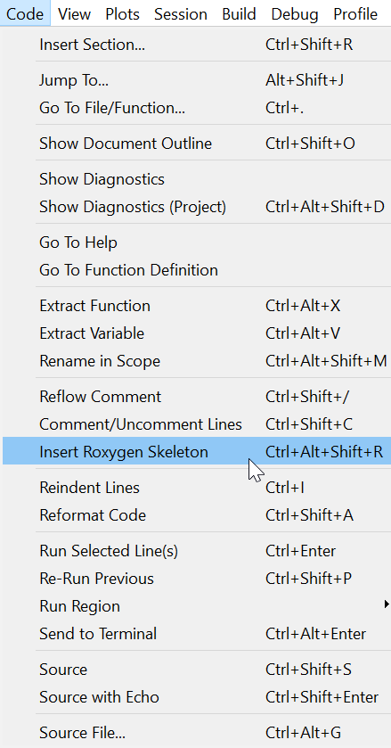
In RStudio,
In the hello.R script, click inside the function → Click Code → Insert Roxygen Skeleton

Slide 25
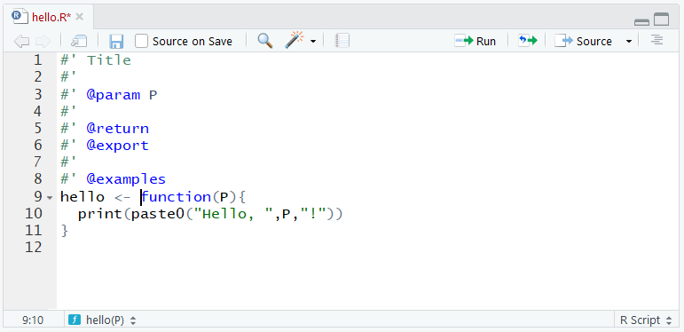
Creating R Packages
COMMENTING YOUR CODE WITH ROXYGEN

Slide 26
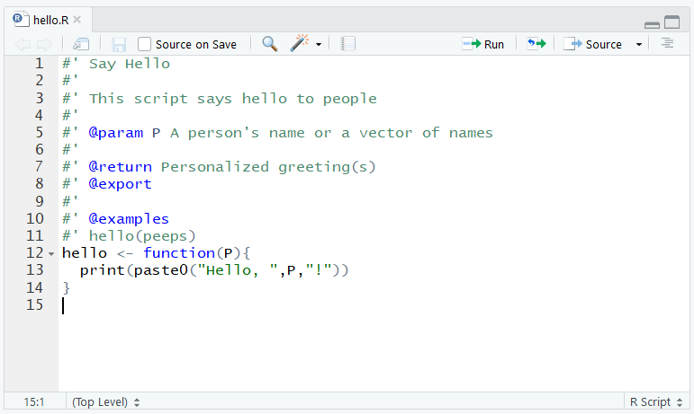
In RStudio,
Add a title, function description, parameter description, what the function returns or prints, and an example usage (example below). Then save.

Slide 27
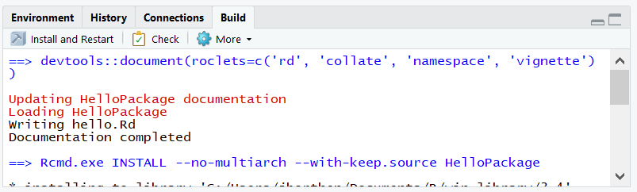
In RStudio,
Click on the Build tab → Click Install and Restart

Slide 28
Creating R Packages
REFERENCES AND RESOURCES
    CRAN’s manual for Writing R Extensions
      https://cran.r-project.org/doc/manuals/r-release/R-exts.html
    Johns Hopkins University’s Coursera course on writing R packages
      https://www.coursera.org/learn/r-packages
    Building R Packages Pre-Flight Check List
      https://github.com/rdpeng/daprocedures/blob/master/lists/Rpackage_preflight.md
    R Packages (Hadley Wickham)
      http://r-pkgs.had.co.nz
    Introduction to the testthat package
      https://journal.r-project.org/archive/2011-1/RJournal_2011-1_Wickham.pdf
    Making an R package
      http://portal.stats.ox.ac.uk/userdata/ruth/APTS2012/Rcourse10.pdf

